Slide 1
The mission of the Seed Biotechnology Center (SBC) is to mobilize the research, educational and outreach resources of UC Davis in partnership with the seed and biotechnology industries to facilitate discovery and commercialization of new seed technologies for agricultural and consumer benefit. The SBC ofers customized courses and programs.
Over 10,000 participants have benefited from the SBC's educational programs.
UPCOMING EDUCATIONAL PROGRAMS
ONLINE
IN-PERSON
Seed Production
February 15-17 & 22-24, 2022
Seed Biology and Quality*
June 28 - 30, 2022
E-Series Short (2 half day) Courses Plant Breeding Academy
February - May 2022:
E-Series #1: Statistics & Experimental Design
E-Series #2: Hybrid Breeding Strategies
E-Series #3: Advanced Statistics & Experimental Design (Coming up on Feb 1 & 3!)
Hemp Breeding and Seed Production*
November 1 - 3, 2022
Seed Business 101 - Horticulture*
November 28 - December 2, 2022
Leadership Program for Plant Breeders*
December 13 - 15, 2022
Class VII in Europe * Starting in October 2022 Applications are open!
*Planned for in-person instruction, but will be contingent upon the ability to follow safety precautions.
sbc.ucdavis.edu • pba.ucdavis.edu • Connect with SBC on
sbc.ucdavis.edu • sbc@ucdavis.edu • Follow SBC on

Slide 2
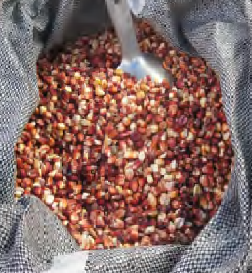
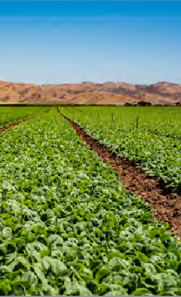
Seed Production
This course is designed to enhance participants’ knowledge of the underlying biology of seed production and the key roles of bees and other insect pollinators, how to manage seed crops from agronomic, quality control, and genetic integrity standpoints, and how to meet new challenges through seed production research. The course includes wet-seeded vegetable crops (cucurbits, tomatoes and peppers), dry-seeded vegetable crops (brassicas, carrots, onions,), and major agronomic crops (canola, and corn). Attention is also given to organic seed production.
Plant Breeding Academy E-Series
A part of UC Davis Plant Breeding AcademySM educational programs, these short courses consisting of two half-days are ofered in an online format only. The curriculums focus on the practical application of theories in statistics, experimental design, quantitative genetics, principles of plant breeding, hybrid breeding, and more. Designed to make immediate impacts on the daily work of your plant breeding teams, and other seed professionals.
Seed Biology and Quality
Presenting the scientific background for production, handling, storage and quality control procedures in the seed industry, this two and a half-day course has been updated and is suited for both beginning and experienced seed professionals.
This course presents the scientific background and technical protocols for assessing, enhancing and maintaining high seed quality and updates participants on new information in these topics, including seed pathology and enhancement.
Hemp Breeding and Seed Production
Designed to enhance the knowledge of professionals working on hemp improvement and propagation, this two-day course covers hemp seed production topics such as flowering, pollination, seed development, harvesting, certification, genomics, genetics, sex expression, breeding schemes and intellectual property protection options.
Seed Business 101
Attracting and retaining talented new employees is a critical challenge for the seed industry. Seed Business 101 was created with input from industry executives to accelerate the careers of promising employees and managers new to the seed industry. Shorten the learning curve of current and future seed leaders, seed professionals, including ag. investors, and help them avoid costly mistakes.
Instructors are experienced and successful seed executives.
Plant Breeding Academy
The Academy is a premium professional development course recognized by the global seed industry. It was designed to increase the supply of professional plant breeders. This program develops and enhances the skills of industry personnel around the world to enable them to become independent plant breeders or to contribute to larger breeding programs. Courses are currently being ofered in the United States, Europe, and Africa.
sbc.ucdavis.edu • pba.ucdavis.edu • Connect with SBC on

